Slide 1


The Future of Israel
BURN, BABY! BURN!
Romans 11
Notes:
Romans 11:1 Has God rejected his own people, the nation of Israel? Of course not!
We LIVE in EXCITING Times!
Pres. Trump ~ Start This!

Slide 2

The Alienation Between Israel & God
Romans 10:20-21 Isaiah [the prophet] is very bold and says [quoting God], "I was found by those who did not seek me, I became manifest to those who did not ask for me.“
But as for Israel He [God] says, “All the day long I have stretched out my hands to a disobedient and obstinate people!"
33 AD Messiah
Jewish Wars 70 AD
Holocaust
Paul Writes 54 AD
For 2000Yrs…?
Notes:
2Day’s Probs = Goes WAY back→ **33 AD
** =GENTILE AGE → Prophesied Ro.10:20
**Ro.10:21 Jews=Rejected JC
G=Tried 40 Yrs → Removed Protection
**2000 Yrs Dispersed→Holocaust

Slide 3
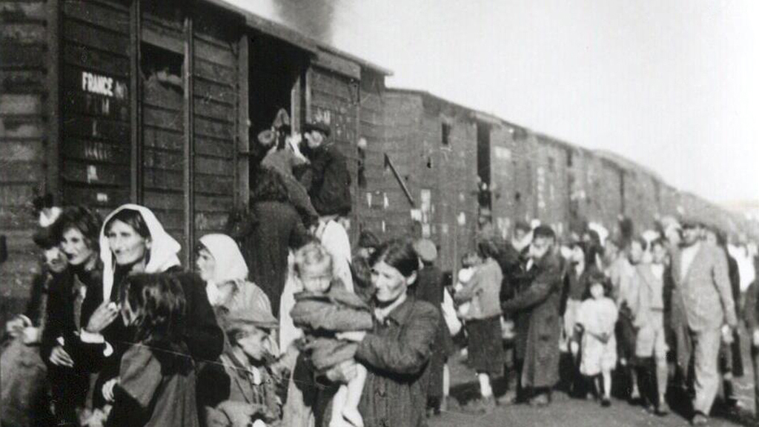
for almost 2000 years…
“Saint” Chrysostom
“Worse than murderers & wild beasts”
“Sacrifice the souls of men”
Synagogues are brothels, den of robbers, & lodging for wild beasts
Middle Ages
Outlawed eating with Jews
Forced baptisms (Heraclius, Leo III, Basil I)
Must wear badges (Innocent III)
No property ownership
1st Crusade financed by killing/plundering Jews
Burned Jews alive singing, “Christ we adore thee!”
The 2009 survey by the Guttman Center found:
Believing in the existence of God – 80%
Not believing in the existence of God – 20%
46% define themselves as “secular”
A 2011 study found that half of all American Jews have doubts about the existence of God,
Wikipedia: Jewish Atheism

Slide 4

“Where is God?”
My Control
God’s Control
Romans 11:1 I ask, then, has God rejected his people?
By no means!
For I myself am an Israelite, a descendant of Abraham, a member of the tribe of Benjamin.
God has not rejected his people whom he foreknew.
Notes:
Rom.11:1=GUD QUEST! →
→ “Foreknew” = **G in Control → Yet w/ **Freedom

Slide 5
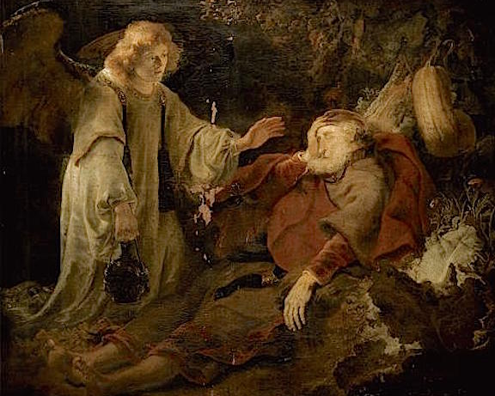
“Where is God?” (Romans 11:1ff)
Do you not know what the Scripture says of Elijah, how he appeals to God against Israel?
“Lord, they have killed your prophets, they have demolished your altars, and I alone am left, and they seek my life.”
But what is God’s reply to him? “I have kept for myself seven thousand men who have not bowed the knee to Baal.”

Slide 6
“Where is God?” (Romans 11:1ff)
So too at the present time there is a remnant, chosen by grace.
The Remnant: “Chosen By Grace”
1 Peter 1:1-2 Peter, an apostle of Jesus Christ, To those who reside as aliens, scattered throughout… who are chosen according to the foreknowledge of God…
Notes:
“Remnant” = of BELIEVERS = Today, Still
“Chosen” = “Elected” → by **G → Foreknowl

Slide 7

“Where is God?” (Romans 11:1ff)
So too at the present time there is a remnant, chosen by grace.
But if it is by grace, it is no longer on the basis of works; otherwise grace would no longer be grace.
By Grace
By Good Works
Notes:
So G= @Work Among **“REMNANT”
“By Grace” = **Implicat. → **Grace ^ Works
GOSP: ~Approach BOTH WAYS

Slide 8
“Where is God?” (Romans 11:1ff)
as the result of the destruction of the Jewish commonwealth and the Second Temple in the year 70 and the consequent upheaval of Jewish social and legal norms…the rabbis were required to face a new reality—mainly Judaism without a Temple (to serve as the center of teaching and study) … It is during this period that rabbinic discourse began to be recorded in writing. Wikipedia, Talmud
So too at the present time there is a remnant, chosen by grace.
But if it is by grace, it is no longer on the basis of works; otherwise grace would no longer be grace.
New Covenant
Talmud
“Messianic Jews” / “Fulfilled Jews”
Grace
Good Works
“Rabbinic Judaism”
Notes:
Today: “Remnant” = Messianic/Fulfilled
**“Gud Works” = Rabinnic Judaism
w/ 2 Diff “Scriptures” → **N.T.=Familiar
**Talmud = **RESULT of “NO TEMPLE”
Why ~Temple? → JC=Sacrificed / BOC=Temple

Slide 9
“Where is Israel?” (Romans 11:7ff)
Jeremiah 31:31-33 (NASB) 31 "Behold, days are coming," declares the LORD, "when I will make a new covenant with the house of Israel and with the house of Judah…I will put My law within them and on their heart I will write it; and I will be their God, and they shall be My people.
What then? Israel failed to obtain what it was seeking.
The elect obtained it,
but the rest were hardened, as it is written, “God gave them a spirit of stupor, eyes that would not see and ears that would not hear, down to this very day.”
Romans 11:9-10 And David says, “Let their table become a snare and a trap, a stumbling block and a retribution for them; let their eyes be darkened so that they cannot see, and bend their backs forever.”
New Covenant Judaism
Talmudic Judaism
Grace
Good Works
Notes:
“?? Is Israel” = G’s Question!! =Impaled on **Grace/Works
Vast Majority = **TALMUDIC Judaism → Law/Law/Law
=Arguing/Splitting/Stipulating 1000s of Laws
=AGONIZING over “How 2 Approach G w/Works”
Result? **v.7 FAILURE
→ ** Elect=Succeeded = **New Coven. = Jer. 33
**Others = STUPOR ** ~Hear/See=SPIRITUAL

Slide 10
“Where is Israel?” (Romans 11:7ff)
Romans 11:25 I want you to understand this mystery, dear brothers and sisters, so that you will not feel proud about yourselves. Some of the people of Israel have hard hearts,
2 Thessalonians 2:7 For the mystery of lawlessness is already at work…
New Covenant Gentiles/Jews
Talmudic Judaism
Grace
Good Works
Notes:
“Mystery” =Spritually Understood = HARD Hrt
=**2Thess. 2:7 → GOSP: ?? ~Recv Grace ??
i.e., ?? Work? Wonder? → G=Makes it Clear!
You’re SO CLOSE! → Why Wander Away?
?? Go In2 Confusion / Darkness → ~G, ~Hope

Slide 11
“Where is Israel?” (Romans 11:7ff)
33 AD Messiah
Jewish Wars 70 AD
1967 Jerusalem Returned to Israel
For 2000Yrs…?
Romans 11:25 I want you to understand this mystery, dear brothers and sisters, so that you will not feel proud about yourselves. Some of the people of Israel have hard hearts,
but this will last only until the full number of Gentiles comes to Christ.
Luke 21:24 and they will fall by the edge of the sword, and will be led captive into all the nations; and Jerusalem will be trampled under foot by the Gentiles until the times of the Gentiles are fulfilled.
Notes:
Hardness = ENDS, WHEN: “Full #...Gentiles…”
=** Lk.21:24 Prophecy → **Timeline

Slide 12
“Where is Israel?” (Romans 11:7ff)
(For I do not want you, brethren, to be uninformed… so that you will not be wise in your own estimation)
Grace
Good Works
Romans 11:28-29 Many of the people of Israel are now enemies of the Good News, and this benefits you Gentiles.
Yet they are still the people he loves because he chose their ancestors Abraham, Isaac, and Jacob.
Romans 11:18 do not be arrogant toward the [Jews]…
Romans 11:22 Behold then the kindness and severity of God; to those who fell, severity, but to you, God's kindness, if you continue in His kindness; otherwise you also will be cut off.
Romans 11:20 Do not be conceited, but fear;
Romans 11:21 for if God did not spare the natural branches, He will not spare you, either.
Notes:
Uninformed… “Y’all had BEST NOT get WISE in your OWN ESTIMATION & write Israel off!”

Slide 13
“Where is Israel?” (Romans 11:7ff)
(For I do not want you, brethren, to be uninformed… so that you will not be wise in your own estimation)
Rom. 11:29 For God’s gifts and his call can never be withdrawn.
God’s Warning Against:
Anti-Semitism
The Holocaust
Opposing Israel
Genesis 12:2-3 I will make you into a great nation. I will bless you and make you famous, and you will be a blessing to others. I will bless those who bless you and curse those who treat you with contempt. All the families on earth will be blessed through you.”
Notes:
11:29 = a SERIOUS Promise
= ** ~Mess w/ JEWS!!
b/c **Gen. 12:2 → ~CONDITIONAL!

Slide 14
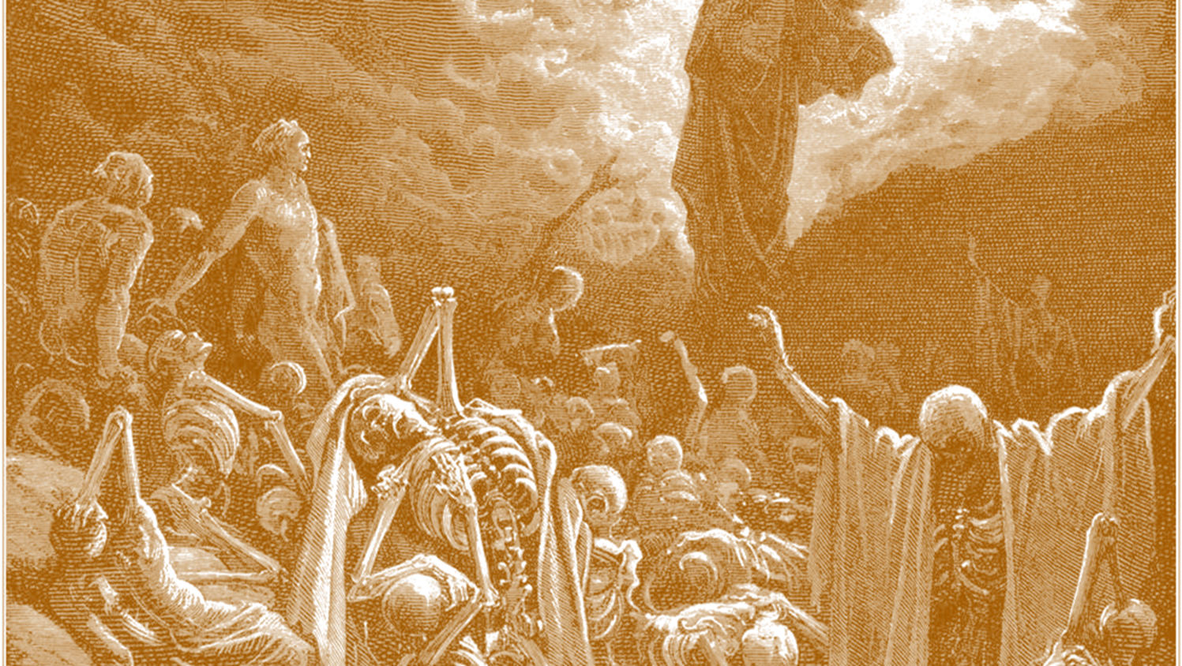
Ezekiel 37:1-3
The LORD took hold of me, and I was carried away by the Spirit of the LORD to a valley filled with bones. ² He led me all around among the bones that covered the valley floor. They were scattered everywhere across the ground and were completely dried out.

Slide 15
Ezekiel 37:1-3
Then he asked me, “Son of man, can these bones become living people again?”
“O Sovereign LORD,” I replied, “you alone know the answer to that.”

Slide 16
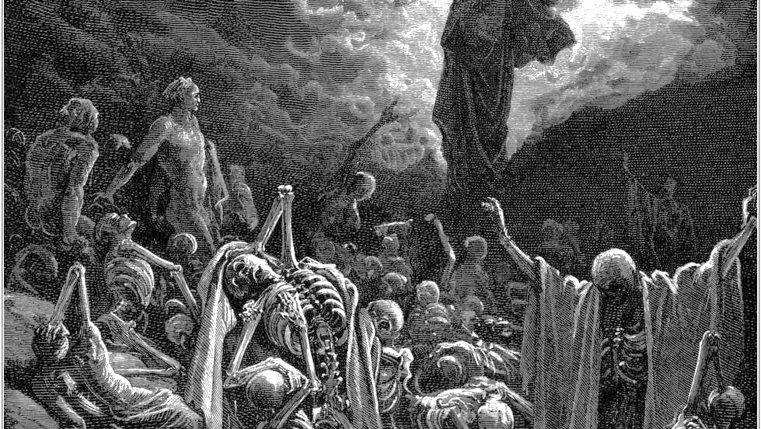
Ezekiel 37:4-6
Then he said to me, “Speak a prophetic message to these bones and say, ‘Dry bones, listen to the word of the LORD!
This is what the Sovereign LORD says: Look! I am going to put breath into you and make you live again!
I will put flesh and muscles on you and cover you with skin. I will put breath into you, and you will come to life. Then you will know that I am Yahweh.’”

Slide 17
Ezekiel 37:7-8
…there was a noise, a rattling sound, and the bones came together, bone to bone…tendons and flesh appeared on them and skin covered them…They all came to life and stood up on their feet—a great army
Then he said to me, “Son of man, these bones represent the people of Israel. They are saying, ‘We have become old, dry bones—all hope is gone. Our nation is finished.’
Therefore, prophesy to them and say, ‘This is what the Sovereign LORD says: O my people, I will open your graves of exile and cause you to rise again. Then I will bring you back to the land of Israel.’
“I will gather the people of Israel from among the nations. I will bring them home to their own land from the places where they have been scattered.

Slide 18
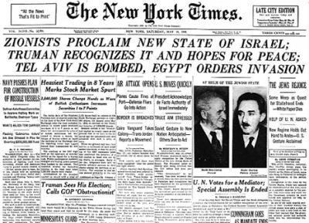
1948
“Then you will know that I am Yahweh”
Rom. 11:29 For God’s gifts and his call can never be withdrawn.
Genesis 12:2-3 …I will bless those who bless you and curse those who treat you with contempt…”
Notes:
In 1948 → “THEN U Will KNOW…!”
Thus **11:29 → Thus **Gen. 12:2-3 = SERIOUS Warning!

Slide 19
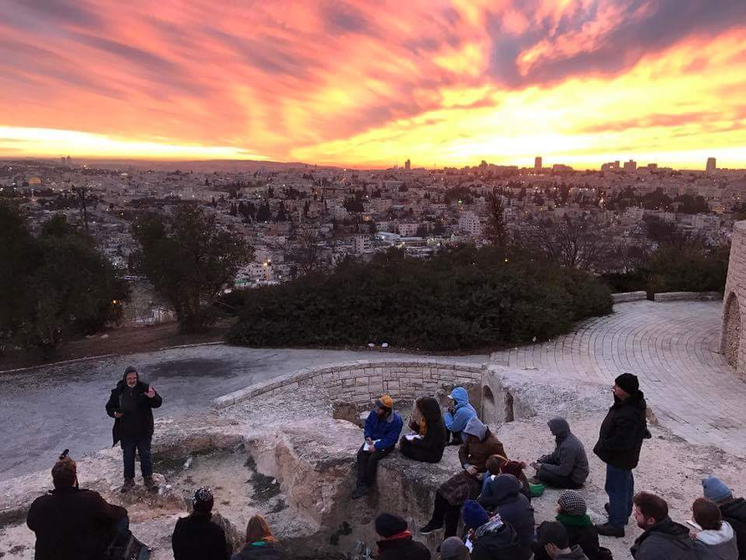
1948
Genesis 12:2-3 …I will bless those who bless you and curse those who treat you with contempt…”
“Then you will know that I am Yahweh”
so that you will not be wise in your own estimation
Romans 11:22 Behold then the kindness and severity of God…
Rom. 11:29 For God’s gifts and his call can never be withdrawn.
Romans 11:18 do not be arrogant…
Romans 11:20 Do not be conceited…
Romans 11:21 ….He will not spare you, either.

Slide 20
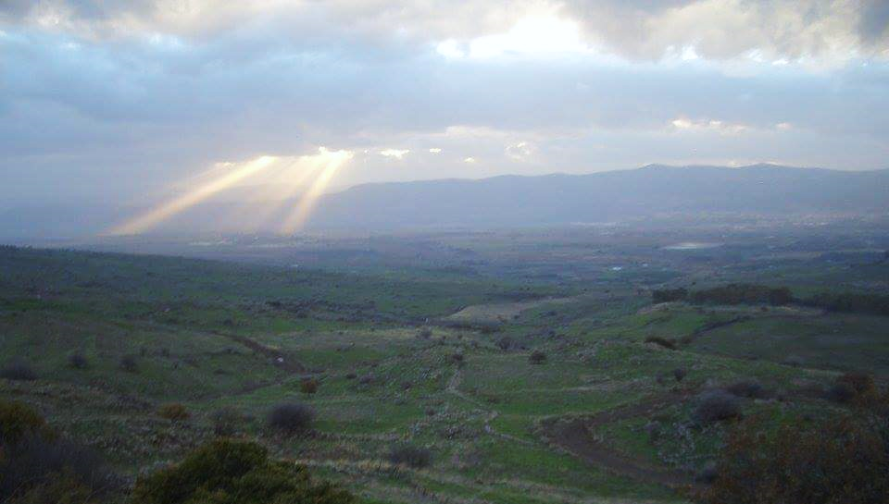
1948
James 4:6 But He gives a greater grace. Therefore it says, "GOD IS OPPOSED TO THE PROUD, BUT GIVES GRACE TO THE HUMBLE."
“Then you will know that I am Yahweh”
Grace
Pride
Rom. 11:29 For God’s gifts and his call can never be withdrawn.
Notes:
All this is another way of saying… Jas. 4:6
=How G. Rolls
Which Means ** Grace ^ Pride
AP: ~Jst Nations → Applies 2 Individ.2!!
AP: Bitter? “Squish..Bug!” Lash Out? CRUSH?
~ 2 Turn 2 G: “Defend Me!” → G:“Defend Urslf!”

Slide 21
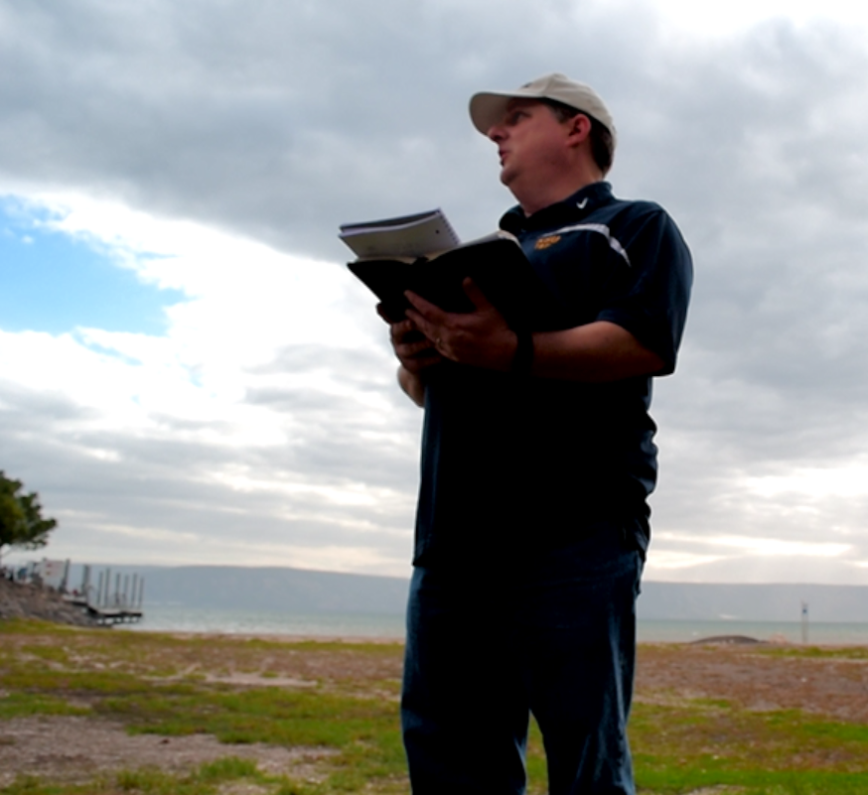
An Example: "GOD IS OPPOSED TO THE PROUD, BUT GIVES GRACE TO THE HUMBLE."
Humble?
Proud?

Slide 22
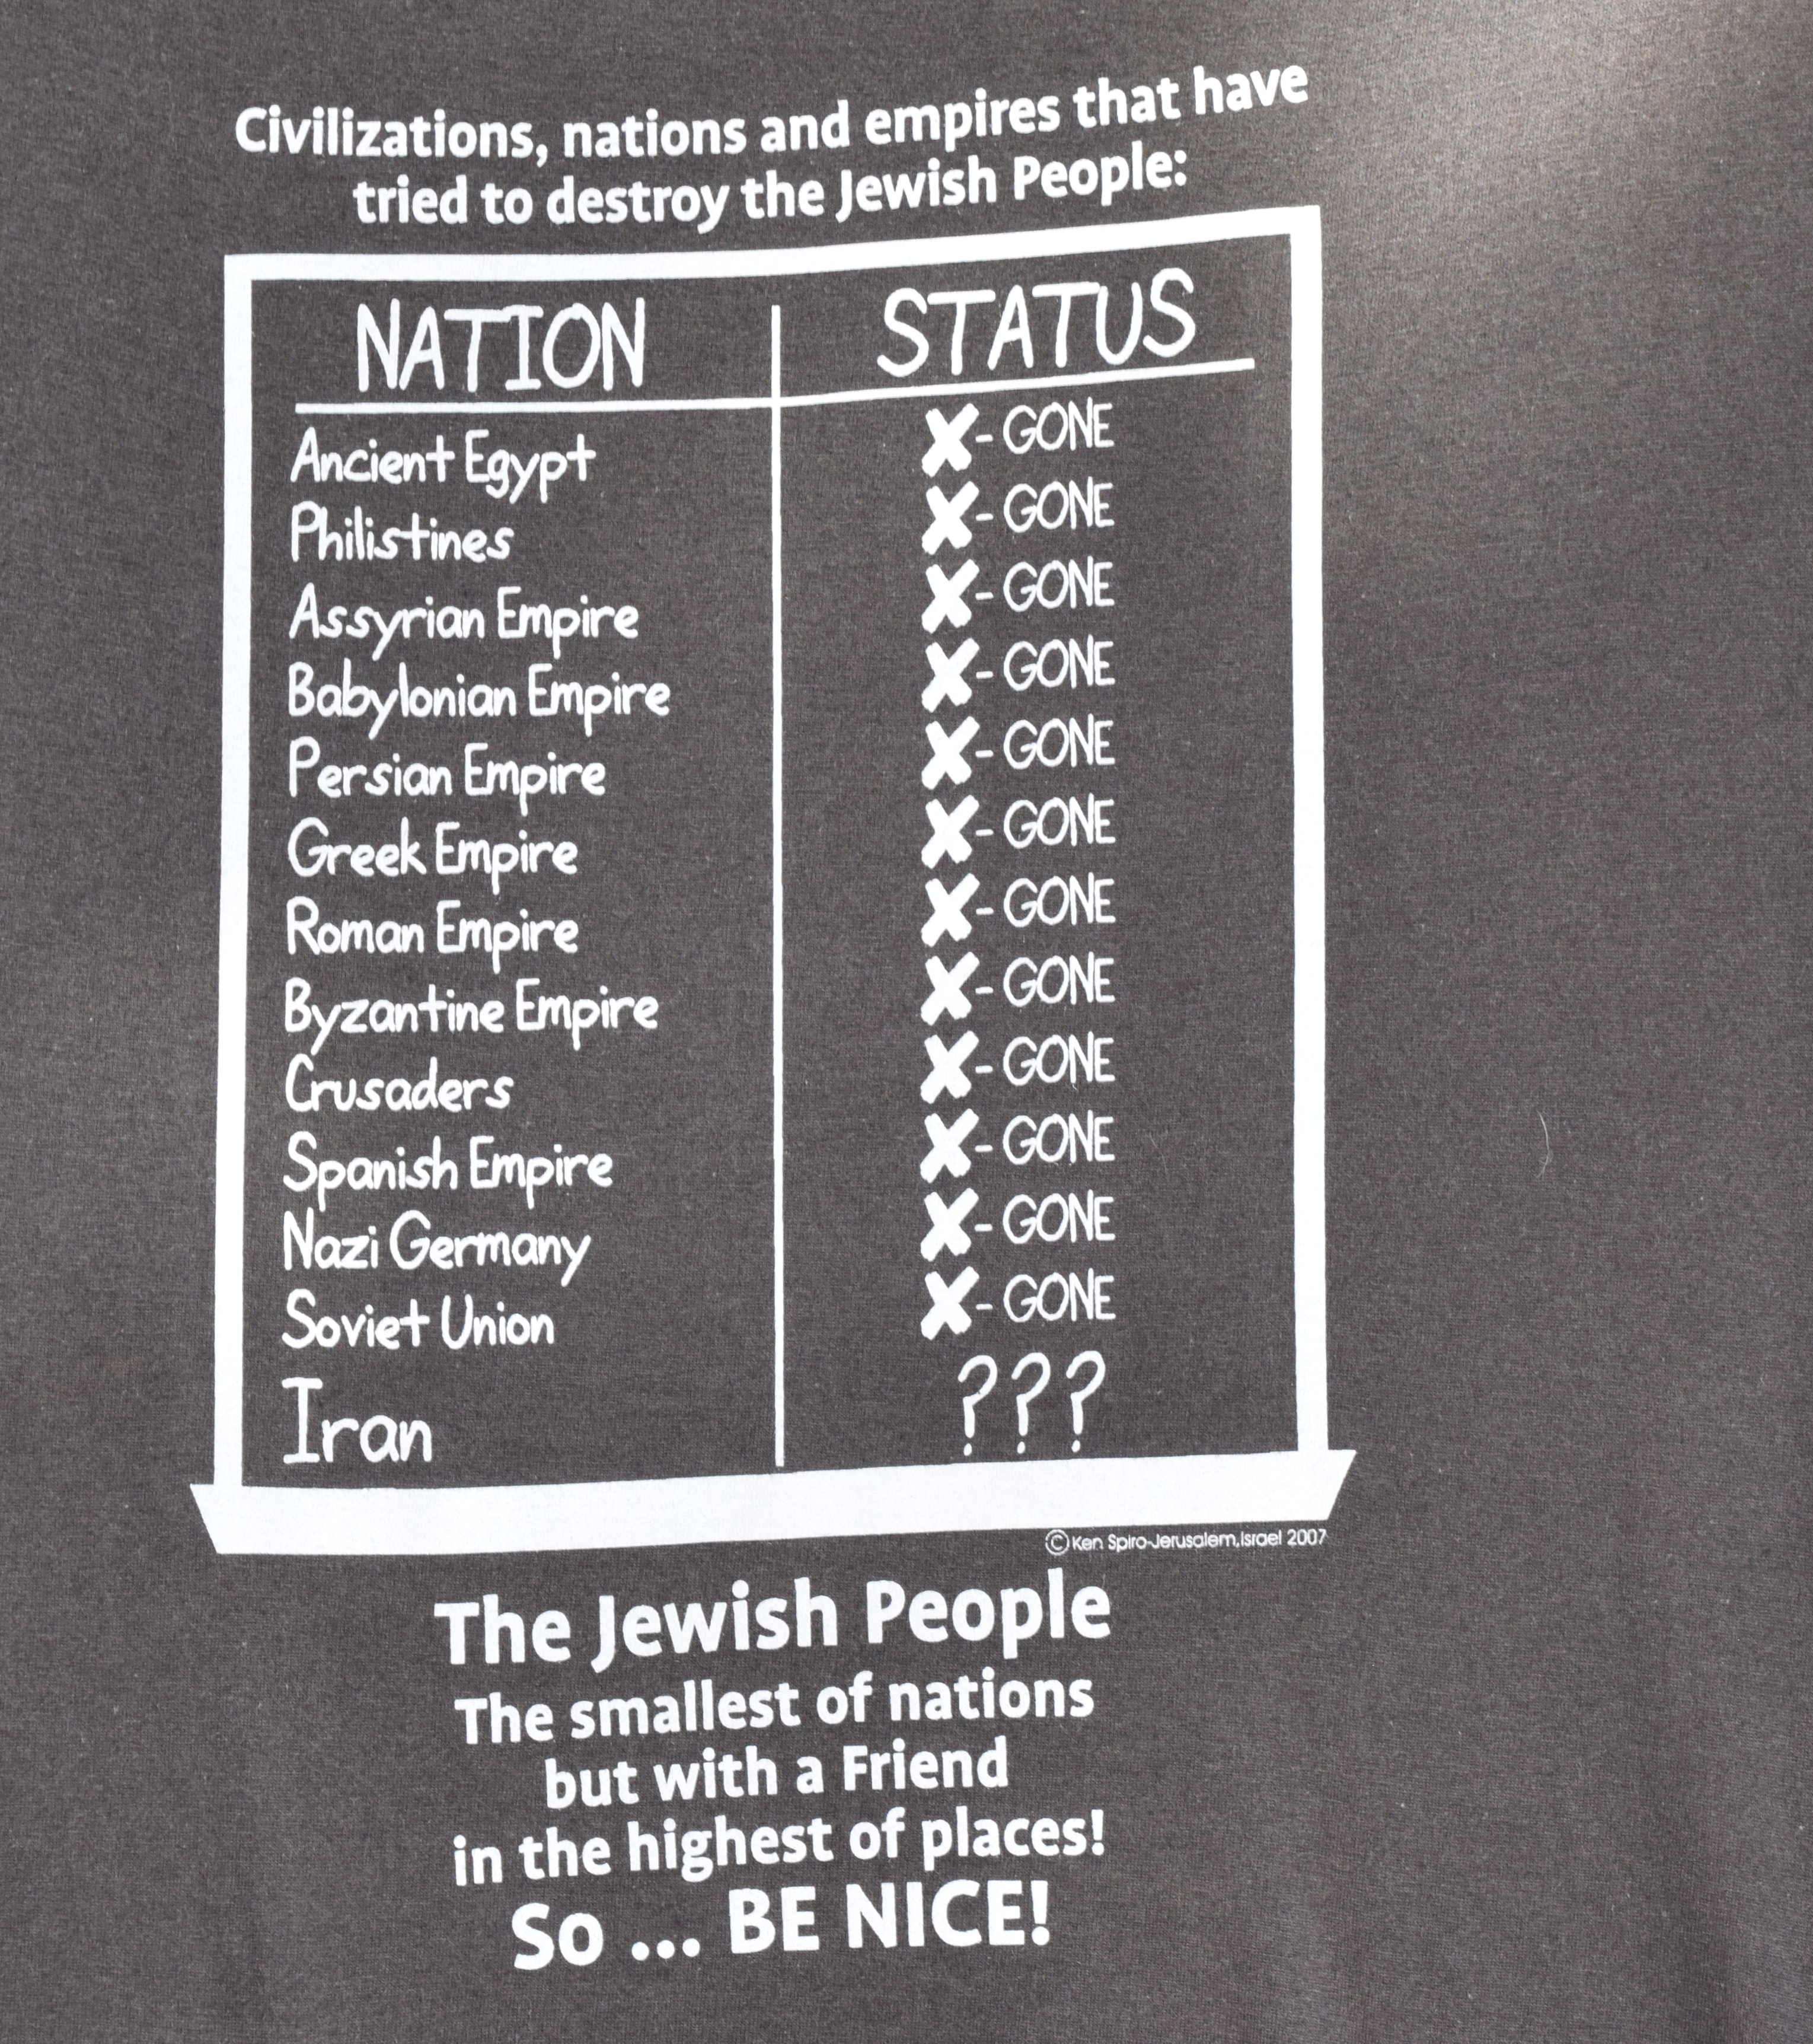
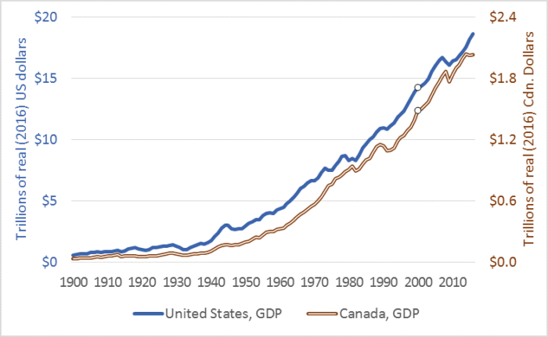
1948
Genesis 12:2-3 …I will bless those who bless you and curse those who treat you with contempt…”
“Then you will know that I am Yahweh”
Protecting Israel
Protecting Jews
Rom. 11:29 For God’s gifts and his call can never be withdrawn.

